Slide 1
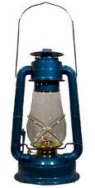
Paul Revere’s Midnight Ride
Miss. Housley
September 21, 2011

Slide 2
Georgia Performance Standards
SS3H2: The student will discuss the lives of Americans who expanded people’s rights and freedoms in a democracy.
a. Paul Revere (independence)
National Standards
NSS-USH.K-4.3: The history of the United States: Democratic principles and values and the people from many cultures who contributed to its cultural, economic, and political heritage.
a. Understands how democratic values came to be, and how they have been exemplified by people, events, and symbols.
National Education Technology Standards
Standard 3: Students apply digital tools to gather, evaluate, and use information. Students: b. locate, organize, analyze, evaluate, synthesize, and ethically use information from a variety of sources and media.
Standard 4: Students use critical thinking skills to plan and conduct research, manage projects, solve problems, and make informed decisions using appropriate digital tools and resources. Students: b. plan and manage activities to develop a solution or complete a project.

Slide 3
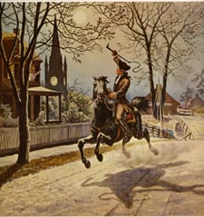
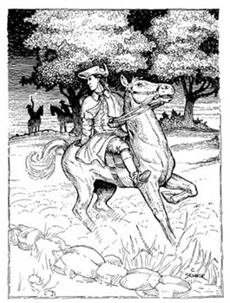
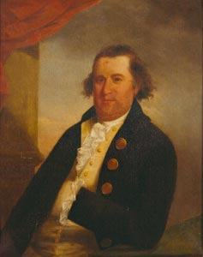
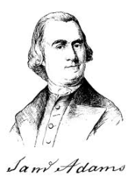
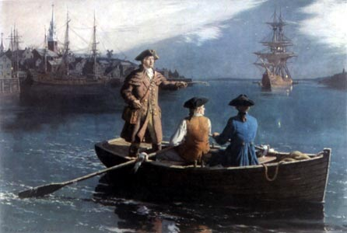
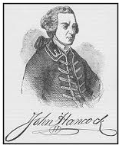
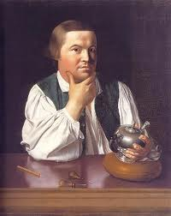
Paul Revere
What things did Paul Revere do to help in the independence movement to bring about rights and freedoms in democracy?
Paul Revere’s Ride
What qualities did Paul Revere possess that made him a hero of democracy?
Patriot
Loyal to his country.
Character Traits
Diligent
In standing up for his beliefs about freedom.
Brave
Because he fought for liberty.

Slide 4
Paul Revere
Paul Revere’s Ride
What things did Paul Revere do to help in the independence movement to bring about rights and freedoms in democracy?
Character Traits
What qualities did Paul Revere possess that made him a hero of democracy?
Notes:
Title, EQ for Paul Revere’s Ride, EQ for Character Quilt

Slide 5
Notes:
Paul Revere’s Ride sequence picture 1

Slide 6
Notes:
Paul Revere’s Ride sequence picture 2

Slide 7
Notes:
Paul Revere’s Ride sequence picture 3

Slide 8
Notes:
Paul Revere’s Ride sequence picture 4

Slide 9
Notes:
Paul Revere’s Ride sequence picture 5

Slide 10
Notes:
Paul Revere’s Ride sequence picture 6

Slide 11
Resources
Google Images
Up with People- Ride of Paul Revere http://www.youtube.com/watch?v=SRO7ZucFAvA

